Slide 1
Welcome To
The Chairperson & Members of
Internal Quality Assurance Cell
Quarterly Meeting
Sept 2022- March 2023
13th April 2023
Go, change the world
RV Institute of
Management

Slide 2
Go, change the world
RV Institute of
Management

Slide 3
Go, change the world
RV Institute of
Management
Agenda
Reading and Approval of the minutes along with the Action Taken Report of the meeting held on 13th August 2022
To brief the members about the seamless conduct of II Sem examinations for the first autonomous 2021-23 Batch and the results
To brief the members about the admissions for 2022-24 Batch
To brief the members about the disbursement of scholarships to the qualified students of the first autonomous batch 2021-23
To brief the members about the statutory body meetings conducted during 2022-23
To discuss about the Infrastructure enhancement in the Institution
To discuss about the new quality initiatives adopted by the institute.
To present the details regarding the institutional achievements
To present the details regarding programmes/ events organized in the Institute during the previous quarter and the way forward.
To seek suggestions from the members regarding continuous quality improvement.
Any other issues with the permission of the chair

Slide 4
Go, change the world
RV Institute of
Management
Welcoming the new members to the IQAC
1. Dr Sen Mathews, Director, Employability & Corporate Relations, Kristu Jayanti College- Member from Academia
2. Mr Chandramouli, Head HR, Abylle Solutions, Bengaluru- Member from Industry
3. Ms Bindu Elakkal, Bren Technologies, Bengaluru- Parent Representative
4. Dr Tamizharasi D, Professor, RVIM
5. Dr Vinay K S, Assistant Professor, RVIM
6. Ms Vibha S Bhat, I Sem MBA- Student Representative
7. Mr Anushruth D- I Sem MBA- Student Representative

Slide 5
Go, change the world
RV Institute of
Management
Agenda Point : 1
Reading and Approval of the minutes of the meeting held on 13th August 2022
The minutes of the previous meeting were approved and following is the summary of Action Taken
Sl. No. | Suggestions | Action taken
1 | To try for sponsorships for recognising top performers- both academic & non-academic | Approached few organisations through our alumni network- discussions are in progress
2 | Faculty members to nurture the connection established during BIP | All faculty mentors compulsorily visiting the organisations during BIP has resulted in strengthening the association- Industry –Institute Interaction sessions are more frequent & effective
3 | To offer PG Diploma programmes by virtue of being autonomous | Curriculum framework and guidelines prepared for the PG Diploma in Business Analytics and got the approval of the statutory bodies and the University.
4 | Best BIP reports, top scorers in Health & Wellness to be rewarded | Top scorers in BIP and Health & Wellness were honoured during the Inauguration of the new batch
5 | Effective implementation of Social Immersion Programme | Total number of NGOs in which our students carried out the SIP is close to 100. Top scorers in SIP will be rewarded during the next inaugural ceremony
6 | Increase the number of scholarships | Management approved 15 scholarships for I ( Top Scorers in PGCET)& II Year ( Top academic performers in I Year) for 2022-24 Batch

Slide 6
Go, change the world
RV Institute of
Management
Agenda Point : 2
To brief the members about the seamless conduct of II Sem examinations for the first autonomous 2021-23 Batch and the results:
Valuation Summary:
Number of Scripts for First valuation = 1246
Number of Scripts for Second valuation = 1246
No. of Scripts for Third valuation = 45
Total No. of Scripts valued = 2537
No. of Evaluators: Internal = 13, External =12, Total = 25
No. of days of valuation = 21 days
Average No. of scripts valued per day = 121

Slide 7
Go, change the world
RV Institute of
Management
Agenda Point : 2 contd….
To brief the members about the II Sem results of the first autonomous batch of MBA 2021-23
Current autonomous batch result summary:
Sl. No | Details | No. of Students | Percentage
1 | No. of Students Appeared | 179
2 | No. of Students passed | 144 | 80.45%
3 | No. of Students Failed | 35 | 19.55%
Result Analysis
Sl. No | Details | No. of Students
1 | First Class with Exemplary | 32
2 | First class with Distinction –A | 98
3 | First Class- B+ | 14
4 | High Second class | -
5 | Second Class- B | -
6 | Pass class | -
7 | Fail | 35
 | Total | 179

Slide 8
Go, change the world
RV Institute of
Management
Agenda Point : 2 contd….
To brief the members about the II sem results of the first autonomous batch of MBA 2021-23
Current autonomous batch result summary:
TOPPERS
Sl. No | Name of the student | Marks obtained | S.G.P.A/CGPA
1 | CHAITANYA KAMATAGI B | 282 | 8.81
2 | NIVEDITHA K SWAMY | 278 | 8.69
3 | SAGI SAMPI | 277.5 | 8.67
4 | VAISHNAVI N | 277 | 8.66
5 | RAMANABOINA ANAND KUMAR | 271.5 | 8.48

Slide 9
Go, change the world
RV Institute of
Management
Agenda Point : 3
To brief the members about the admission and commencement of the second autonomous batch of MBA 2022-24 Batch.
Admissions Summary:
Year | Intake | Total students admitted | Students from other states | PGCET first round GM cut-off | Reconciliation seats | Gender Split Boys Girls
2017-18 | 180 | 172 | 19 | 731 | - 25 | 102 | 70
2018-19 | 180 | 180 | 21 | 517 | + 4 | 118 | 62
2019-20 | 180 | 180 | 23 | 461 | + 8 | 93 | 87
2020-21 | 180 | 180 | 19 | 417 | + 12 | 98 | 82
2021-22 | 180 | 180 | 28 | 336 | +10 | 107 | 73
2022 -23 | 180 | 180 | 17 | 214 | + 4 | 116 | 64

Slide 10
Go, change the world
RV Institute of
Management
Agenda Point : 3 cont…
To brief the members about the admission and commencement of the Second autonomous batch of MBA 2022-24 Batch
Current autonomous batch status:
Started the batch on 01.02.2023
Completed MID SEMESTER EXAMS recently
Planning to conduct final semester end exams during 22.05.2023 to 12.06.2023
Business Immersion will happen during 19.06.2023 to 29.07.2023

Slide 11
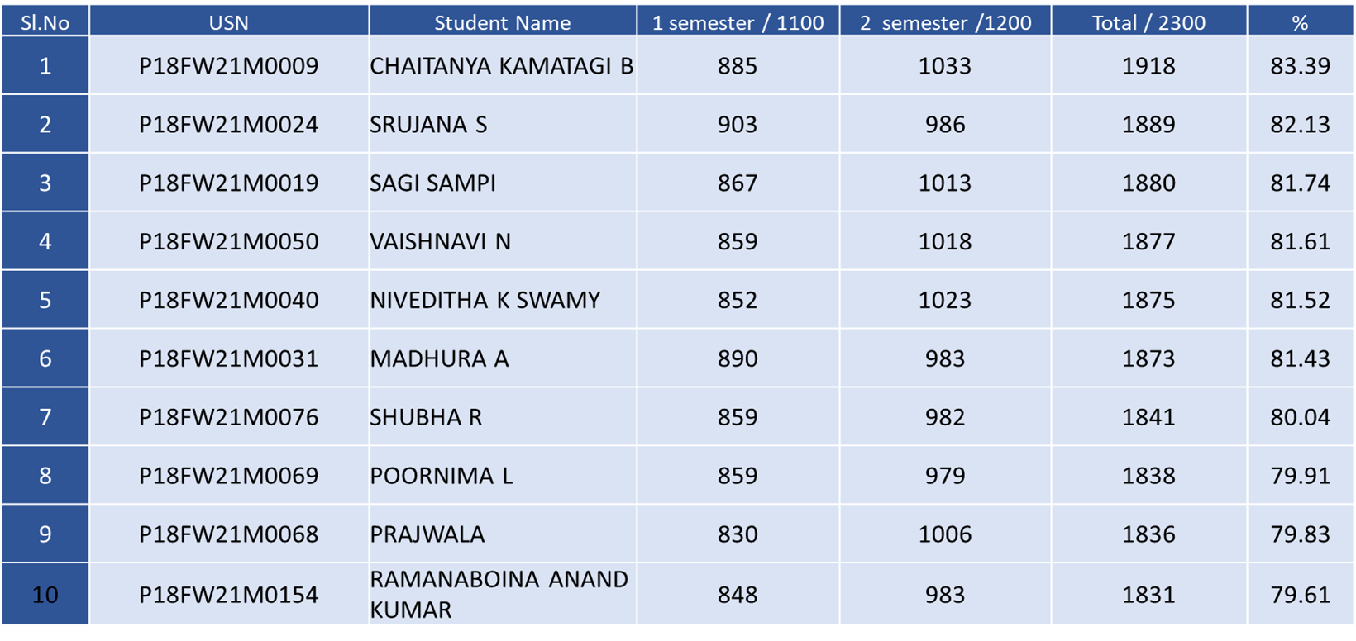
Go, change the world
RV Institute of
Management
Agenda Point : 4
To brief the members about the disbursement of scholarships to the qualified students of the first autonomous batch 2021-23
TOP 10 scholarship details

Slide 12
Go, change the world
RV Institute of
Management
Agenda Point : 4 contd….
Scholarships successfully disbursed to the top performers in Health & Wellness and Business Immersion( Above 7.0 CGPA) - 2021-23 Batch
TOP Scorer details
Sl.no | Reg.no | Name | CIA | SEE | Marks/100 | %
Health & Wellness – 21MBA823
1 | P18FW21M0096 | B SHASHANK | 48 | 43 | 91 | 91%
Business Immersion – 21MBA821
1 | P18FW21M0140 | YASHWANTH R | 42 | 48 | 90 | 90%
2 | P18FW21M0179 | SAAHIL SRIKANT KULLOLI | 46 | 44 | 90 | 90%

Slide 13
Go, change the world
RV Institute of
Management
Agenda Point : 5
To brief the members about the statutory body meetings conducted during 2022-23
The meetings were held as follows:
Board of Studies meeting- 06.12.2022
Academic Council Meeting- 19.12.2022
Finance Committee Meeting- 29.12.2022
Governing Body Meeting- 09.01.2023

Slide 14
RV Institute of
Management
Go, change the world
Governing Body approval of the curriculum framework, academic regulations, guidelines and detailed syllabi of the PGDBA Programme recommended by BoS, ratified by the AC and accepted by FC.
Annexure 6 (a) Academic Regulations.pdf
Annexure 6 (b) Examinations Manual.pdf
Annexure 6 (c) PGDBA SYLLABUS.pdf

Slide 15
RV Institute of
Management
Go, change the world
Governing Body approval of the academic regulations, guidelines and Syllabi for course work for the Autonomous Ph.D Programme, recommended by BoS , ratified by Academic Council and accepted by Finance Committee.
Annexure 7 (a) PhD Guidelines as per UGC regulations 2022.pdf
Annexure 7 (b ) PhD Syllabus for Common Courses 2022.pdf

Slide 16
RV Institute of
Management
Go, change the world
Governing Body approval of the provision for fast track semester with examinations from the next academic year
Annexure 9 - Fast track Examination.pdf

Slide 17
Go, change the world
RV Institute of
Management
Agenda Point : 6
To brief the members about the Infrastructure enhancement in the Institution
Refurbishment of IQAC & Centre for Research & Consultancy
Refurbishment of Centre for Wellness
Setting up of Centre for Peace and Yoga

Slide 18
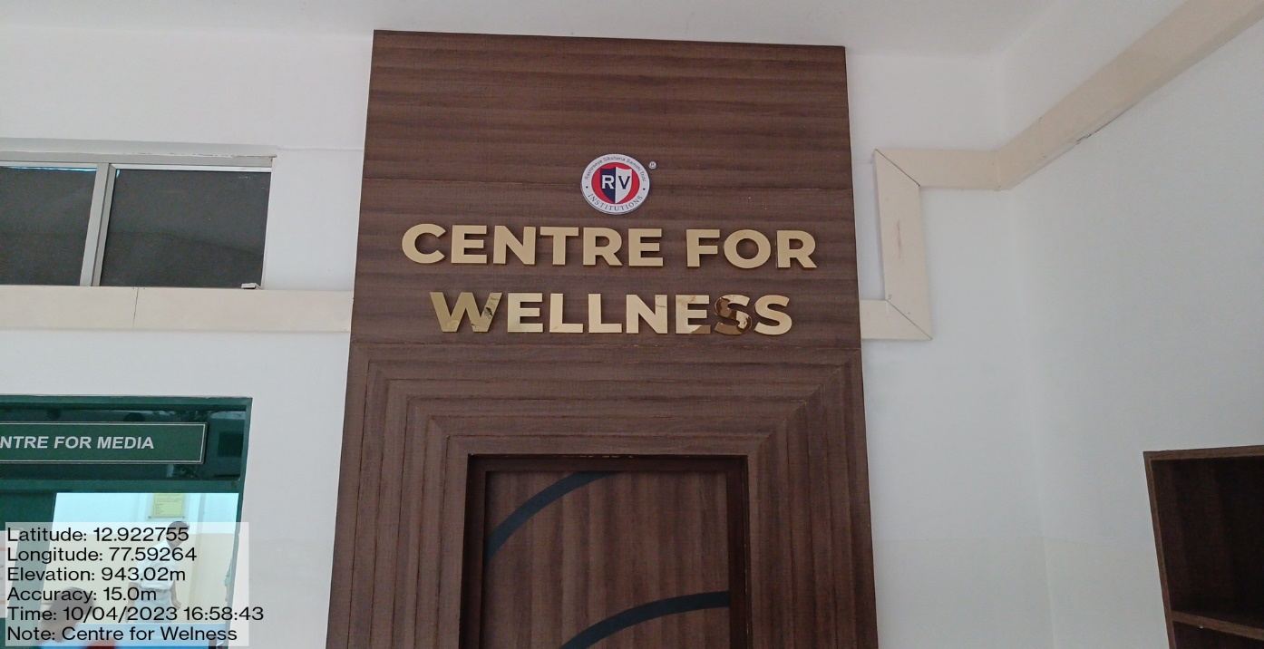
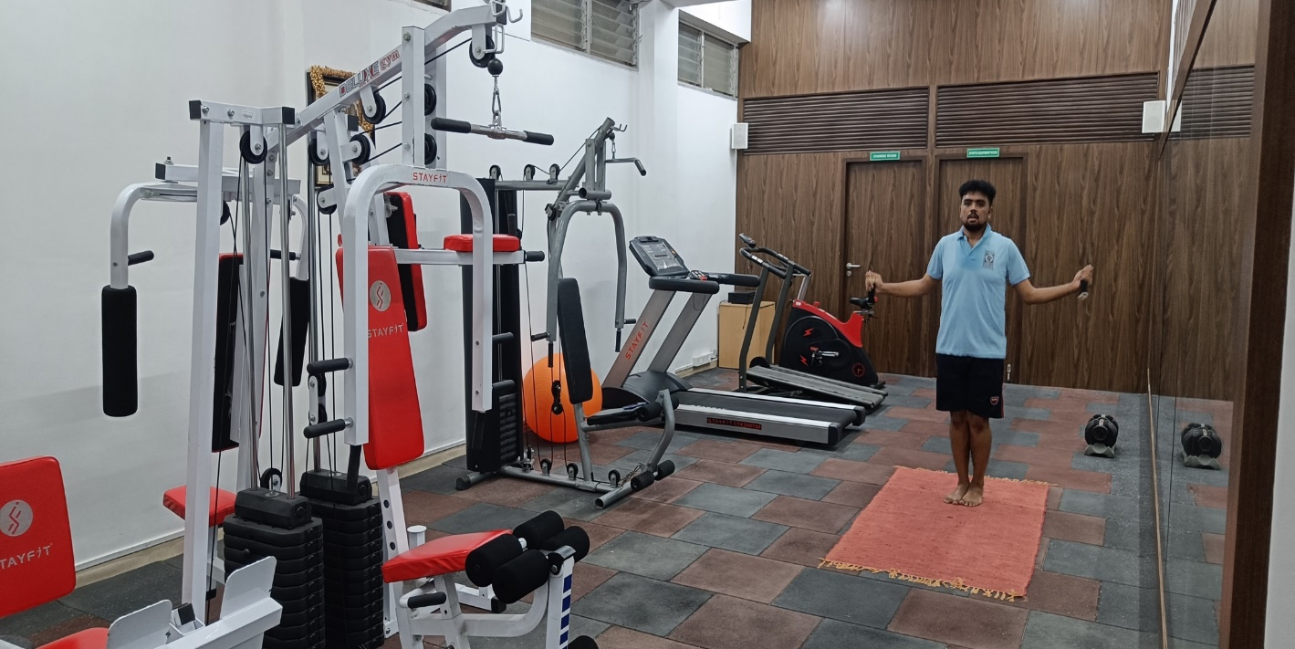
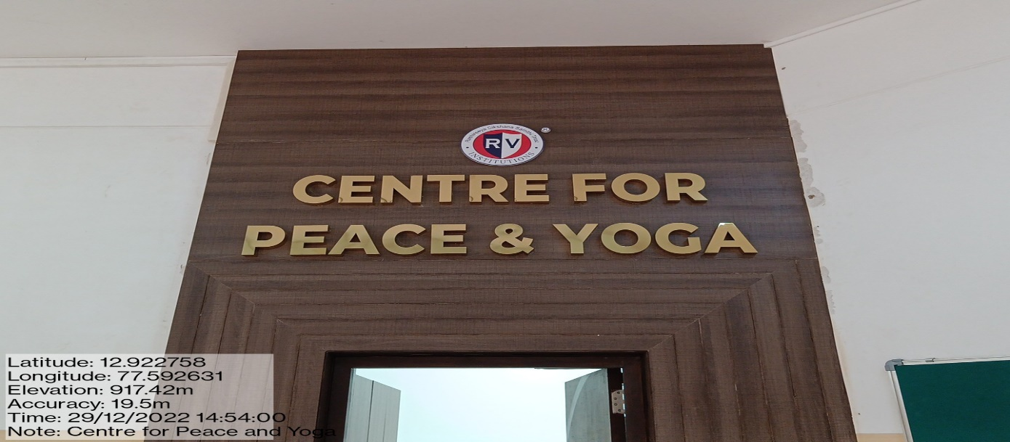
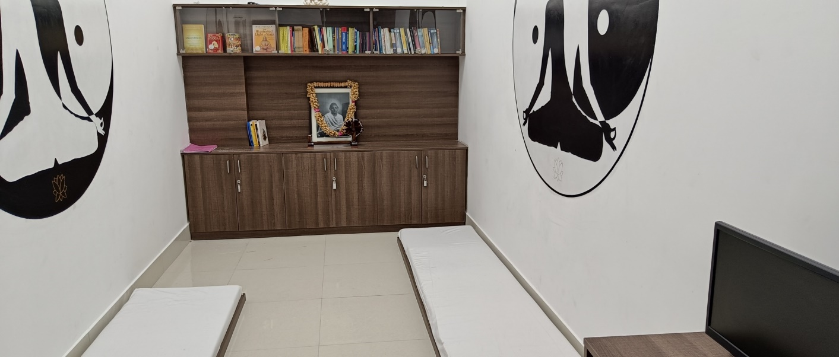
Go, change the world
RV Institute of
Management
Infrastructure

Slide 19
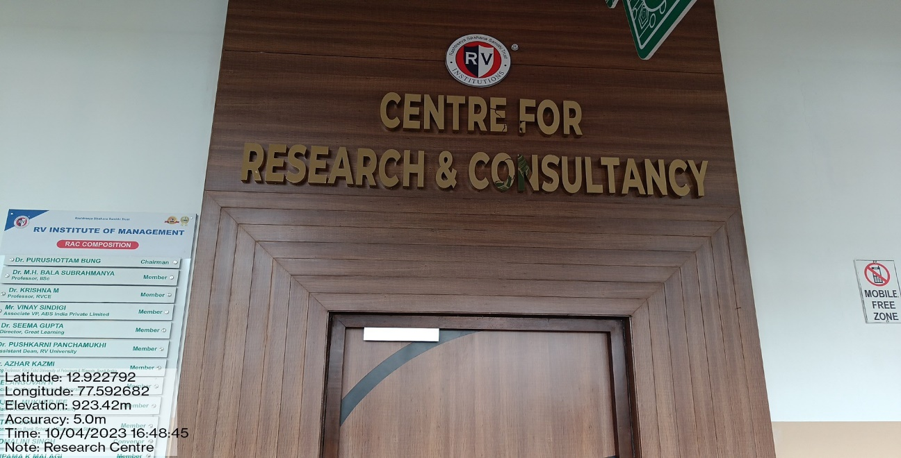
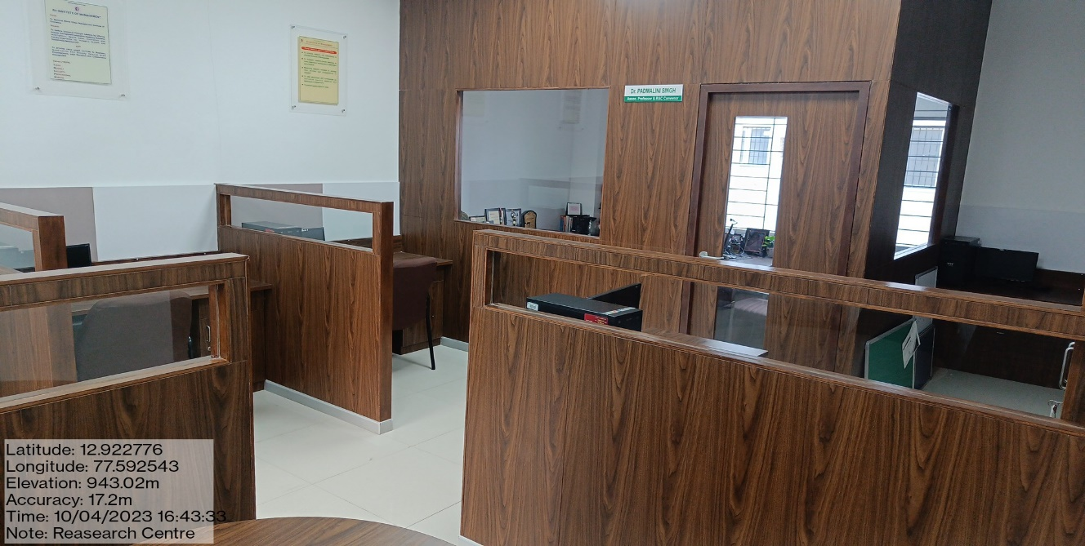
Infrastructure

Slide 20
Go, change the world
RV Institute of
Management
Agenda Point : 7
To discuss about the new quality initiatives adopted by the institute:
Launching of certificate course in Predictive Analytics using R in association with Boston IT Solutions India Pvt Ltd. The duration is 2 months including Capstone Project
Institutional funding for research proposals wherein faculty members are encouraged to submit minor research proposals for a duration of six months and research grants will be sanctioned to those proposals which are approved by the RAC.
Collaboration with NSMART to get exposure to live stock trading. Accordingly, 33 licenses were subscribed.
Regular industrial & institutional visits organized – Visit to IKEA, IIMB, IISC, Labour Commissioners Office, etc
Successfully completed Social Immersion Programme for II Sem students
Successfully completed Domain Specific Skill course by Mentor Mind- which helped in students working on real time projects from companies called Menternships. MOU has been executed with Mentor Mind
Domain specific skill course enriched by offering Applications of AI & ML in the various functional domains like HR, Marketing & Finance
Students have completed minimum 3 courses maximum of 5 courses on Coursera platform as part of open electives

Slide 21
Go, change the world
RV Institute of
Management
Agenda Point : 7
New quality initiatives Contd.. :
Institution has becoming life time member of BMA so as to facilitate conducting major events
One Day FDP by Talent Matrix and Five faculty members got CBMA certification
Encouraging students to present and publish their papers ( from SIP and BIP) in National and International conferences
Institution has becoming Associate Centre of Indian Yoga Association
Institution has becoming life member of Analytics Society of India, IIMB
Recognition of faculty and student champions by QUIKLRN LMS for maximum usage of the platform
Working on launching on 2 certificate courses – Story telling and Data Visualisation using Tableau and Machine Learning using Python
Planning to offer Outbound training programs to the 1st Sem students as part of Principles of Management

Slide 22
Go, change the world
RV Institute of
Management
Agenda Point : 8
To present the details regarding programmes organized in the Institute during the previous quarter and the way forward.

Slide 23
Go, change the world
RV Institute of
Management
Programmes (FDP/MDP/Symposium/Workshops/CEP/Certificate courses) organized
SI.No | Date | Events/Activity Organized | Resource Person/Designation
1 | 14th October -2022 | Walkathon Financial Literacy Rally in association with CDSL | Mr. C.S Harisha (Regional Head- Karnataka), CDSL
2 | 14th to 19th November 2022 | Conducted 1 week PGCET Crash course | Dr. Dileep & Prof. Pooja T
3 | 12th & 13th January 2023 | FDP on Bibliometric Analysis in Association with AIMA | Dr.Mathirajan, Chief Research Scientist, IISc, Bangalore. Dr.Ashulekha Gupta, Professor, Graphic Era Deemed to be University, Dr.Bijay Prasad Kushwaha, Asst.Professor, VIT University, Vellore
4 | 2nd February, 2023 | Session for 1st Sem- Quiklrn LMS | Mr. Agniv and Ms. Ashwini
6 | 2nd February, 20203 | Quiklrn LMS – Digital Teaching Learning Champion Faculty Felicitation | Mr. Agniv and Ms. Ashwini
7 | 6th March 2023 | RVIM Challenge - Union Budget 2023 | Mr. Ravi Kumar Mr.Chandra Shekar
8 | 5th January-8th February 2023 | Course o Individual Taxation(ITTC) | CA Padmini
9 | 4th-28th March 2023 | Course on Power BI(ITTC) | Prof. Nagasubba Reddy
10 | 15th February-3rd March 2023 | Course on Corporate Tax(ITTC) | Dr. Dileep

Slide 24
Go, change the world
RV Institute of
Management
Programmes (FDP/MDP/Symposium/Workshops/CEP/Certificate courses) organized
SI.No | Date | Events/Activity Organized | Resource Person/Designation
11 | 6th August, 2022 | #Entrepreneurship Webinar on "How did I get Investment?" Panel Discussion | Sheik Shamuillah, Shiroi Lily Shazia, Vikrant Pandey
12 | 1st October, 2022 | #Entrepreneurship Webinar on "Journey of Entrepreneur", Jaipur Rugs | Shri, Nandkishore Cahidhary
13 | November 14, 15, 2022 | Venture Fest 4.0 2k22 | Mr. Kishore, Ms Thirtha Uttappa
14 | November 18th, 19th, 2022 | SEE Doctoral Colloquium | SEE, Dr. Satyajit Majumdar, Dr. Mathew Manimala, Dr. Suresh Bhagawantulla
15 | 10th March, 2023 | Business Plan Poster Making Competetion | Mr. Giridhar Soundararajan, Founder, Barrel Motors
16 | 6th August, 2022 | #Entrepreneurship Webinar on "How did I get Investment?" Panel Discussion | Sheik Shamuillah, Shiroi Lily Shazia, Vikrant Pandey
17 | 10th October 2022 | Meet the Executive | Mr. Supreeth Y S
18 | 28th September 2022 | Meet the Executive | Dr. Vijay Padaguri (Alumni)
19 | 28th September 2022 | Estate Planning | Mr. Vijay Upendra, Consultant, Propseva
20 | 2nd September 2022 | Meet the Executive | Mr. Pawan Shetty (Alumni)

Slide 25
Go, change the world
RV Institute of
Management
Programmes (FDP/MDP/Symposium/Workshops/CEP/Certificate courses) organized
SI.No | Date | Events/Activity Organized | Resource Person/Designation
21 | 7th February, 20203 | Business Government & Society February 2023 | Prof. A Chandran
22 | 2 & 3 Feb, 2023 | Orientation for 1st Sem | Mr. Ram G Vallath, Ms. Ramya Siddharth, Ms. Deepika, Mr. Arvind Varier
23 | 4th Feb., 2023 | Har Ghar Dhyan - initiative by Ministry of Culture, Govt. of India | Mr. Manisha & Mr. Mohit Sanjeev - Art of Living
24 | 28th Oct, 2022 | Seminar on Human Anatomy | Dr. Jahan Zeb (HOD - Department of Human Anatomy) KLE Institute of Dental Sciences
25 | 20th, 21st & 22nd September 2022 | Workshop on Food & Nutrition | Dr. Trupthi Bagul Khairnar (BAMS & PGd Clinical Nutrition) Ojas Ayurveda & Nutrition Clinic, Bengaluru
26 | 13th & 15th October, 2022 | Workshop on General First Aid | Team from RV College of Nursing
27 | 16th February, 2023 | Session on Stress De-stress | Ms. Shagun & Ms. Kriti (Interns MSc. Counselling Psychology) Christ University Bangalore

Slide 26
Go, change the world
RV Institute of
Management
Programmes (FDP/MDP/Symposium/Workshops/CEP/Certificate courses) organized
SI.No | Date | Events/Activity Organized | Resource Person/Designation
28 | 22nd Sept, 2022 | MBA Job Ready Certification courses | Mr.Abdul Rehman, upGrade
29 | 21st Sept, 2022 | Online courses | R.Fathima, Mentor Mind
30 | 22nd Sept, 2022 | Estate Planning | Mr.Vijay Updendra, Propseve Consultancy Firm
31 | 23rd Sept, 2022 | New Trends in Marketing – Guest Lecture | Mr.Vanugopal Gupta,( Ex- General, General Manager, Joint Venture and outsourcing, HAL, Bengalure.
32 | 27th, 28th Sept, 2022 | Student Development Programme on “Environment, Social & Social Governance;(ESG) | LetsTagon, A social Enterprise, Bangalore.
33 | 31st Oct, 2022 | Birth Anniversary of Sri Sardar Vallabhbhai Patel as ‘Unity Day’ in India under aegis of Azadi Ka Amrit Mahotsav | Dr,Vinay
34 | 7th Nov,2022 | Contemporary Trends in HRM | Mr.Chandramouli- Human Resource and L & D Abylle Solutions, Bangalore and Mr naddem Pasha, Talent Acquisition ,Head, Robert Technologies, Bengaluru.
35 | 17th Nov,2022 | Introduction to Commodity Derivatives in association with MCX | Mr Shrikant Koundinya, Assistant Vice-President, MCX, Mumbai.

Slide 27
Go, change the world
Programmes (FDP/MDP/Symposium/Workshops/CEP/Certificate courses) organized
RV Institute of
Management
SI.No | Date | Events/Activity Organized | Resource Person/Designation
36 | 3rd Dec, 2022 | International Day of Persons with Disabilities – Awareness Jatra – an Awareness walk | RVIM staff
37 | 21st Dec, 2022 | Free Eye Power Checkup | Lens and Meds- OneGen Healthcare Pvt.Ltd
38 | 22nd and 23rd Dec, 2022 | Application of Design Thinking in Higher Education – NAAC sponsored | Dr Purushottam Bung
39 | 4th Feb, 2023 | Introductory session on Meditation and mental health under ‘Har Ghar Dhyan’ campaign | Art of Living Foundation
40 | 14th Feb, 2023 | Intellectual Property Rights(IPR) under National Intellectual Property Awareness Mission(NIPAM) | For RVIM staff and students
41 | 27th Feb, 2023 to 4th March, 2023 | Certificate course on Marketing Analytics | Mr.Mithun, Co-ordinator, Business Analytics Programme
42 | 25th Feb, 2023 | INIZIO, Management Fest | Art Man Club

Slide 28
Go, change the world
RV Institute of
Management
Programmes (FDP/MDP/Symposium/Workshops/CEP/Certificate courses) organized
SI.No | Date | Events/Activity Organized | Resource Person/Designation
43 | 15th -22nd February 2023 | Certification course on Analytics in Major HR | Prof. Mithun
44 | 1st- 8th March 2023 | Certification course on Analytics in Major Finance | Prof. Mithun
45 | 23rd-28th February 2023 | Certification course on Analytics in Major Marketing | Prof. Mithun
46 | 1st February 2023 till date | Domain Specific course from Mentormind for all Major Specialization | Mentormind resource people and RVIM Faculty Members
47 | 24th August 2022-24th September 2022 | Certification course on Auditing | Prof. Pooja
48 | 25th January 2023 | EY Leadership programme | Mr. Rachit Singh
49 | 30 January 2023 | Journey of an Entrepreneur | Mr. Sudhakar Pai, MD-Kurlon Pvt. Ltd
50 | 14th January 2023 | Meet the Executive | Mr. Srikanth (Alumni)
51 | 5th November 2022 | Orientation session on Mentormind | Mr. Clinton Dsouza

Slide 29
Go, change the world
Programmes (FDP/MDP/Symposium/Workshops/CEP/Certificate courses) organized
RV Institute of
Management
SI.No | Date | Events/Activity Organized | Resource Person/Designation
52 | 27th Feb, 2023 | Mathrubhasa Diwas – Quiz on the topic “ Bhasha n Samskruthi | For all students
53 | 28th March, 2023 | Industrial visit to IKEA Showroom | For all students
54 | 3rd October, 2022 | Guruvandana | RVIM in association with Pranav Foundation
55 | 28th Sept, 2022 | Strategic Retreat-2022 | RVIM Staff
56 | 16th October, 2022 | Graduation Day | Chief Guest Industry- Mr Ashwin Norohna, COO, Mumbai International Airport Chief Guest Academia- Dr YSR Murthy, Vice Chancellor, RV University
57 | 8th March 2023 | International Womens’ Day Panel Discussion & Bike Rally | Dr Vijayalakshmi Balekundri- Cardiologist, Jayadeva Institute of Cardiology Smt Rama, CEO, ELCIA Mrs Neetha Revankar, Former CFO, Sasken Technologies

Slide 30
Go, change the world
Programmes (FDP/MDP/Symposium/Workshops/CEP/Certificate courses) organized
RV Institute of
Management
SI.No | Date | Events/Activity Organized | Resource Person/Designation
58 | 18th August 2022 | Guest lecture on Emerging Retail Formats | Mr. Mahesh Pavan Sathavalli, Program Manager,Mphasis India Pvt Ltd, Bangalore Karnataka, India
59 | 16and 17th September 2022 | Workshop on Business Analytics was organized as First Round (Technical round) of International Business Plan Championship 2022 on the behalf of makeintern.com in collaboration with IIM Calcutta | Mr. Kushal, Business Analytics Trainer, NASSCOM Foundation, India
60 | 13th April 2023 | Emerging Trends in Logistics | Prof. Venkatesh, Adjunct Faculty, RVIM

Slide 31
RV Institute of
Management
Go, change the world
Update on Placements
Particulars | 2020-22 | 2021-23 (Ongoing)
Total no. of companies (on/off campus) | 70 | 43
Total no. of students | 177 | 178
No. of students not opted for placements | 11 | 2
Total no. of students opted for placements | 167 | 176
No. of students placed | 154 | 130
Effective % of placements | 92% | 74%
Maximum CTC offered | 12.59L/A | 13.56L/A
Median Package | 6L/A | 6.2L/A

Slide 32
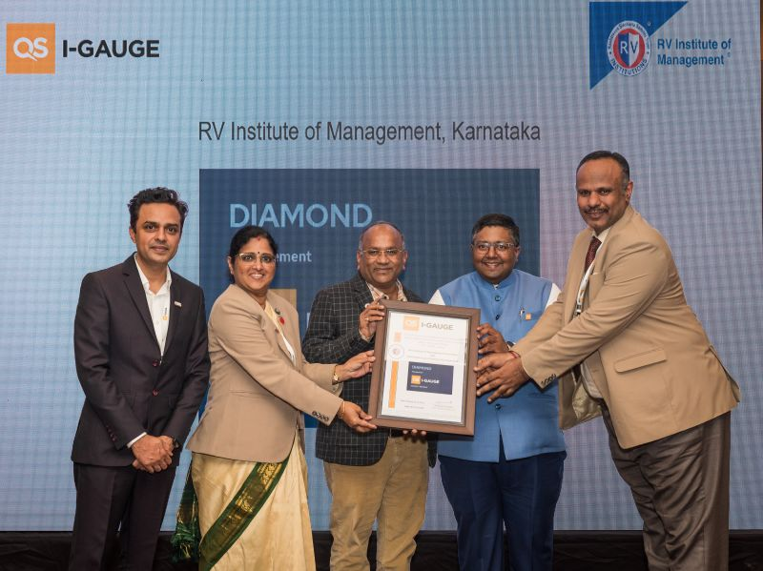
Institutional achievements
RV Institute of
Management
Go, change the world
Conferred with Diamond Rating in the Subject Rating Category by QS I Gauge Global Ranking Agency during Nov 2022.

Slide 33
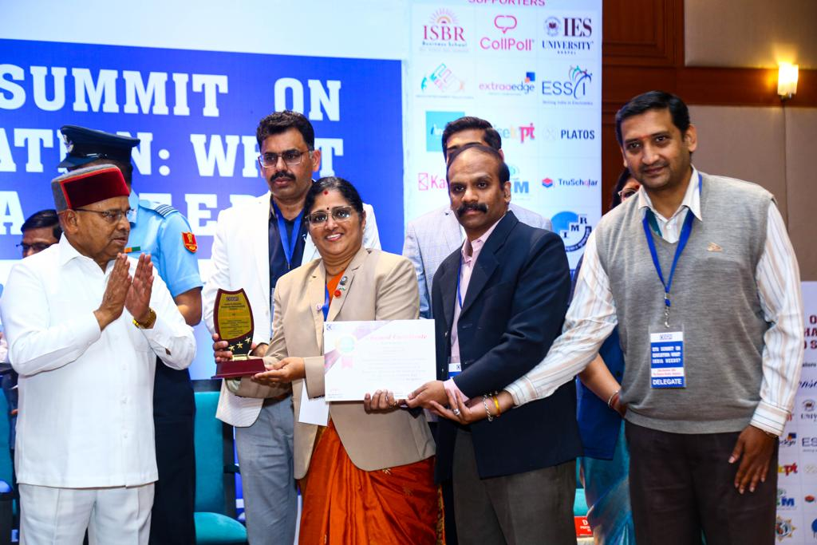
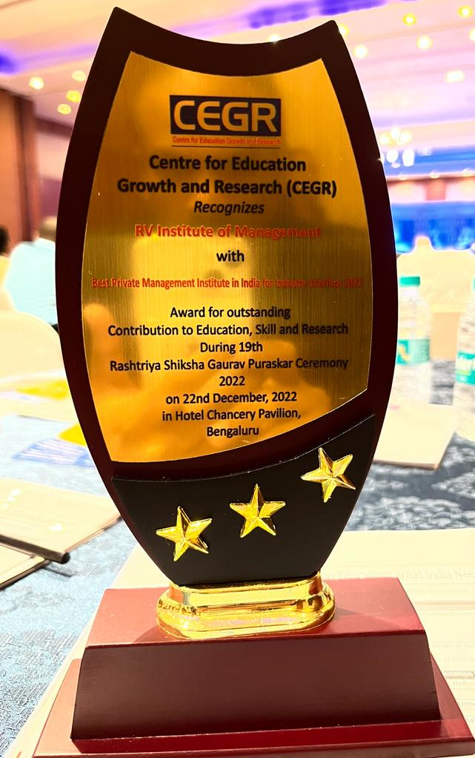
Institutional achievements
RV Institute of
Management
Go, change the world
RVIM Received award from Hon’ble Governor of Karnataka Shri Thawarchand Ghelot for the best private management institution for Industry Interface for its contribution in Education, Skill development and Research during the 19th Rashtriya Shiksha Gaurav Puraskar Ceremony 2022.

Slide 34
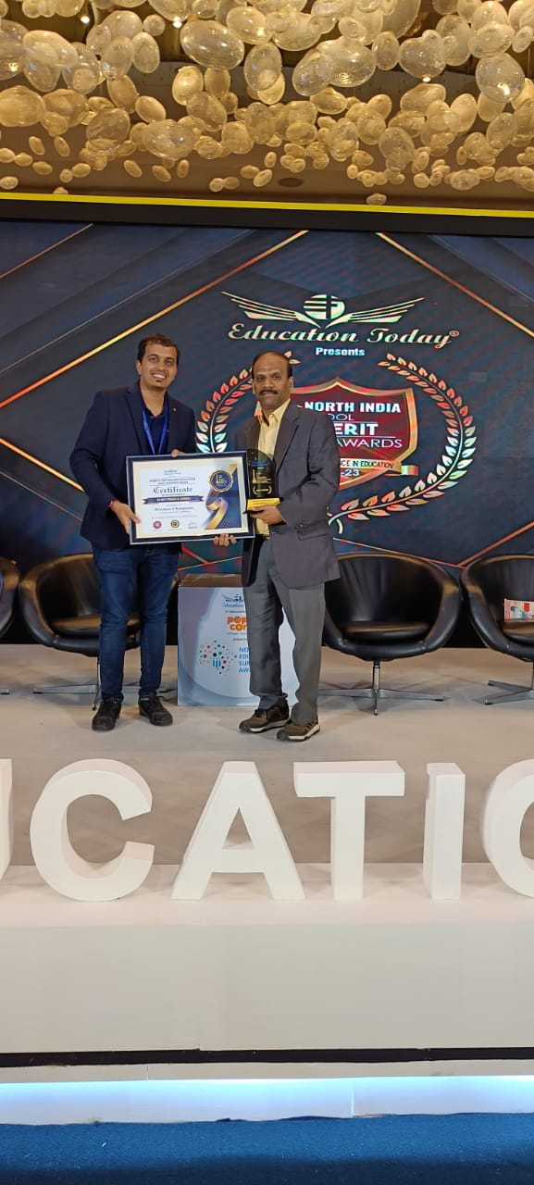
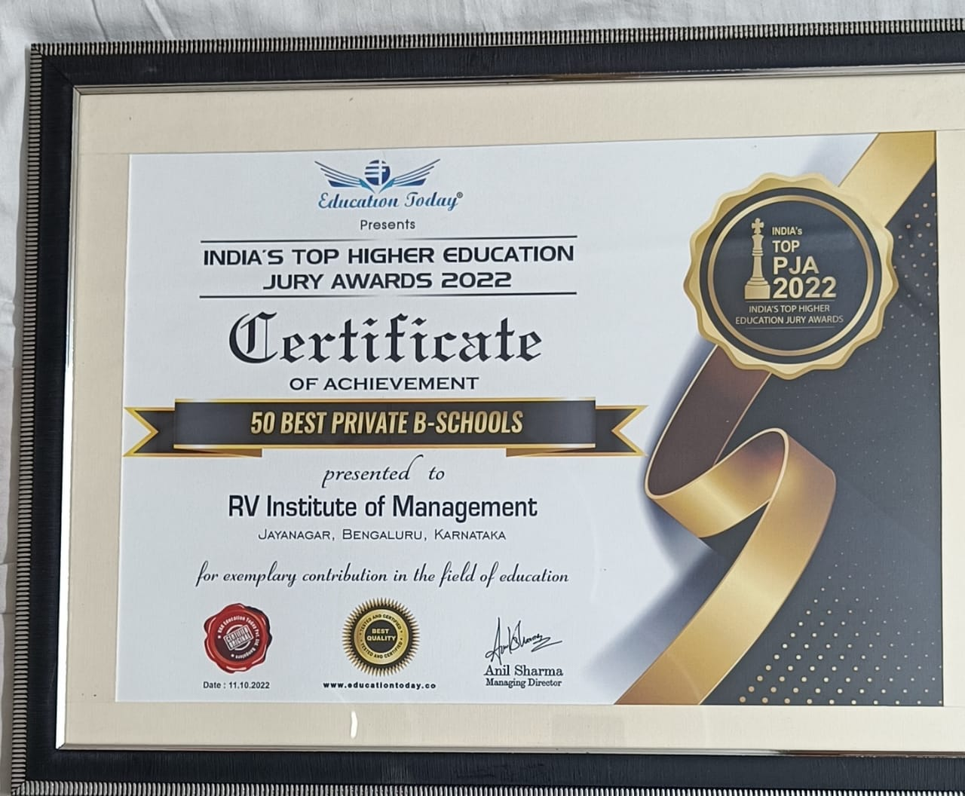
Institutional achievements
RV Institute of
Management
Go, change the world
RVIM was recognised with the Higher Education – Jury Award as one of the TOP B-Schools of the 50 best Private B-Schools, on 11th October, 2022

Slide 35
Go, change the world
Institutional Achievements: B School Ranking
RV Institute of
Management
B-Schools Ranking
Sl. No. | Magazine | Ranking Category | Rank | Rank
 |  |  | 2022 - 23 | 2021 - 22
1 | Business Today | Over All Ranking | 118 | 129
 |  | ROI | 25 | 25
 |  | Private B-Schools | 90 | 100
 | The Week | Private B-Schools | 86 | 86
 |  | B-Schools Private South Zone | 25 | 25
 |  | B-Schools Bengaluru | 10 | 10
3 | India Today | All India | 90 | 100
4 | Outlook | All India - Top Private MBA | 58 | 63
 |  | B-Schools Private South Zone | 20 | 20
 |  | B-Schools Private Bengaluru | 6 | 6
 | Open | Top Standalone B-School South Zone | 18 | -
 |  | Top Standalone B-School State wise ( Karnataka ) | 9 | -
6 | Education Post | Private B-Schools | 45 | 55
 |  | B- School South Zone PVT | 13 | -
 |  | Top - 50 School of Eminence for Employability | 44
 |  | Top - 50 School of Eminence for Employability - South Zone | 15 | -
7 | Careers 360 | B-School - Bengaluru | AA+ | -
8 | MBA Universe.com | Online B- School Ranking | 71 | -

Slide 36
Go, change the world
Major events organised – Video links
RV Institute of
Management
Graduation Day - RVIM Videos\Graduation Day 2020-2022 Batch.mp4
Common Yoga Protocol - RVIM Videos\Free Certification Program on Yoga - Common Yoga Protocol at RVIM.mp4
Genesis 2022-24 Batch - RVIM Videos\Genesis 2022-24 Batch at rvim.mp4
Womens’ Day Programme- RVIM Videos\Bike Rally _ International Women's Day 2023 Celebration _ RVIM.mp4
Venture Fest 2022 - RVIM Videos\Venture Fest.mp4
Guruvandana 2022 - RVIM Videos\Guruvandhana.mp4

Slide 37
Go, change the world
RV Institute of
Management
Agenda Point : 9
To seek suggestions from the members regarding continuous quality improvement

Slide 38
Go, change the world
RV Institute of
Management
Agenda Point : 10
Any other issues with the permission of the chair

Slide 39
Go, change the world
RV Institute of
Management
Discussions.....

Slide 40
Go, change the world
RV Institute of
Management
THANK YOU

