Slide 1
Welcome To
The Chairperson & Members of
Internal Quality Assurance Cell
Quarterly Meeting
May 2022-July 2022
13th August 2022
Go, change the world
RV Institute of
Management

Slide 2
Go, change the world
RV Institute of
Management

Slide 3
Go, change the world
RV Institute of
Management
Agenda
Reading and Approval of the minutes along with the Action Taken Report of the meeting held on 30th April 2022
To brief the members about the seamless conduct of examinations for the first autonomous 2021-23 Batch and the results
To brief the members about the disbursement of scholarships to the qualified students of the first autonomous batch 2021-23 and increase in the number of scholarships
To brief the members about the formation of RAC and conduct of the first meeting
To brief the members about the forthcoming statutory body meeting scheduled in August/ September 2022
To discuss about the Infrastructure enhancement in the Institution
To discuss about the new quality initiatives adopted by the institute.
To present the details regarding programmes organized in the Institute during the previous quarter and the way forward.
To seek suggestions from the members regarding continuous quality improvement.
Any other issues with the permission of the chair

Slide 4
Go, change the world
RV Institute of
Management
Agenda Point : 1
Reading and Approval of the minutes of the meeting held on 30th April 2022
The minutes of the previous meeting were approved and following is the summary of Action Taken
Sl. No. | Suggestions | Action taken
1 | To take an undertaking from the students regarding the code of conduct | Implemented through the mentorship program- Every mentor has ensured that the student has read and understood the code of conduct
2 | MOOCs should be an integral part of the regular courses | MOOCs are already included as part of Course Docket and are being considered for IA component
3 | Scholarships for non-academic performance/ extra-curricular activities | Discussed and decided to recognise the top performers in non-academic areas/ extra- curricular activities with token of appreciation ( Apart from the approved scholarships)
4 | To strengthen the industry- academia connect | As part of Business Immersion Programme- faculty members visited the organisations to strengthen the connect
5 | Effective implementation of Social Immersion Programme | Series of orientation sessions being organised
6 | Increase the number of scholarships | Management approved 15 scholarships for I & II Year for 2022-24 Batch

Slide 5
Go, change the world
RV Institute of
Management
Agenda Point : 2
To brief the members about the seamless conduct of examinations for the first autonomous 2021-23 Batch and the results
For the first autonomous batch, End Semester Examinations were conducted from 21.5.2022 to 8.6.2022. The SEE included both Theory and Practical Examinations.
All the answer scripts were subjected to TWO valuations. Each answer script was valued by Internal Examiner (Faculty of RVIM) and External Examiner.
The final marks for each student was calculated on the basis of the average of two valuations. The deviations between the first and second valuation more than 20 marks was subjected to Third valuation. The marks awarded by the valuator of third valuation is final.
Results were announced within a span of One Month

Slide 6
Go, change the world
RV Institute of
Management
Agenda Point : 2 contd….
To brief the members about the results of the first autonomous batch of MBA 2021-23
Current autonomous batch result summary:
Sl. No | Details | No. of Students | Percentage
1 | No. of Students Appeared | 180
2 | No. of Students passed | 142 | 78.88
3 | No. of Students Failed | 38 | 21.12
Result Analysis
Sl. No | Details | No. of Students
1 | First Class with Exemplary | 10
2 | First class with Distinction –A | 87
3 | First Class- B+ | 43
4 | High Second class | 02
5 | Second Class- B | -
6 | Pass class | -
7 | Fail | 38
 | Total | 180

Slide 7
Go, change the world
RV Institute of
Management
Agenda Point : 2 contd….
To brief the members about the results of the first autonomous batch of MBA 2021-23
Current autonomous batch result summary:
TOPPERS
Sl. No | Name of the student | Marks obtained | S.G.P.A/CGPA
1 | SRUJANA S | 228/27 | 8.44
2 | CHAITANYA KAMATAGI B | 226.5/27 | 8.39
3 | MADHURA A | 223.5/27 | 8.28
4 | SAGI SAMPI | 221.5/27 | 8.20
5 | PRAMOD K L | 219.5/27 | 8.13

Slide 8
Go, change the world
RV Institute of
Management
Agenda Point : 3
To brief the members about the disbursement of scholarships to the qualified students of the first autonomous batch 2021-23 and increase in the number of scholarships:
Scholarships successfully disbursed to the top ten rank holders in the PGCET ( within top 100 ranks ). Same extended to the II year also for the top ten performers in I year SEE ( Above 7.0 CGPA)- 2021-23 Batch
Management has approved for the scholarships to the top 15 rank holders in PGCET ( within top 100 ranks). Same extended to the II year for the top 15 performers in I year SEE ( Above 7.0 CGPA)- 2022-24 Batch

Slide 9
Go, change the world
RV Institute of
Management
Agenda Point : 4
To brief the members about the formation of RAC and conduct of the first meeting:
The first meeting of the RAC was conducted on 25.07.2022. Following is the composition of the RAC:
Name | Designation | Current Affiliation
Dr. M.H. Bala Subrahmanya | Professor | Department of Management Studies, Indian Institute of Science
Dr. Krishna M | Professor and Head | Department of Mechanical Engineering, RV Engineering College
Dr. Vinay Sindigi | Associate Vice President – South Asia | ABS India Private Limited, Bengaluru
Dr. Seema Gupta | Director -Business Programmes | Great Learning-E-Learning Providers, Bengaluru
Dr. Pushkarni Panchamukhi | Assistant Dean | R V School of Economics and Finance, R V University
Dr. Azhar Kazmi | Visiting Professor | King Fahd University of Petroleum & Minerals, Dhahran, Saudi Arabia
Dr. Elangovan N | Associate Professor | BUSINESS AND MANAGEMENT, Christ University
Dr. Ujjal Mukherjee | Area Chair, OB and HR Area | CMS B School, Jain University

Slide 10
Go, change the world
RV Institute of
Management
Agenda Point : 5
To brief the members about the forthcoming statutory body meeting scheduled in August/ September 2022
We Plan to hold the meetings as follows:
Board of Studies meeting- 17th August 2022
Academic Council Meeting- 1st September 2022
Finance Committee Meeting- 15th September 2022
Governing Body Meeting- 29th September 2022

Slide 11
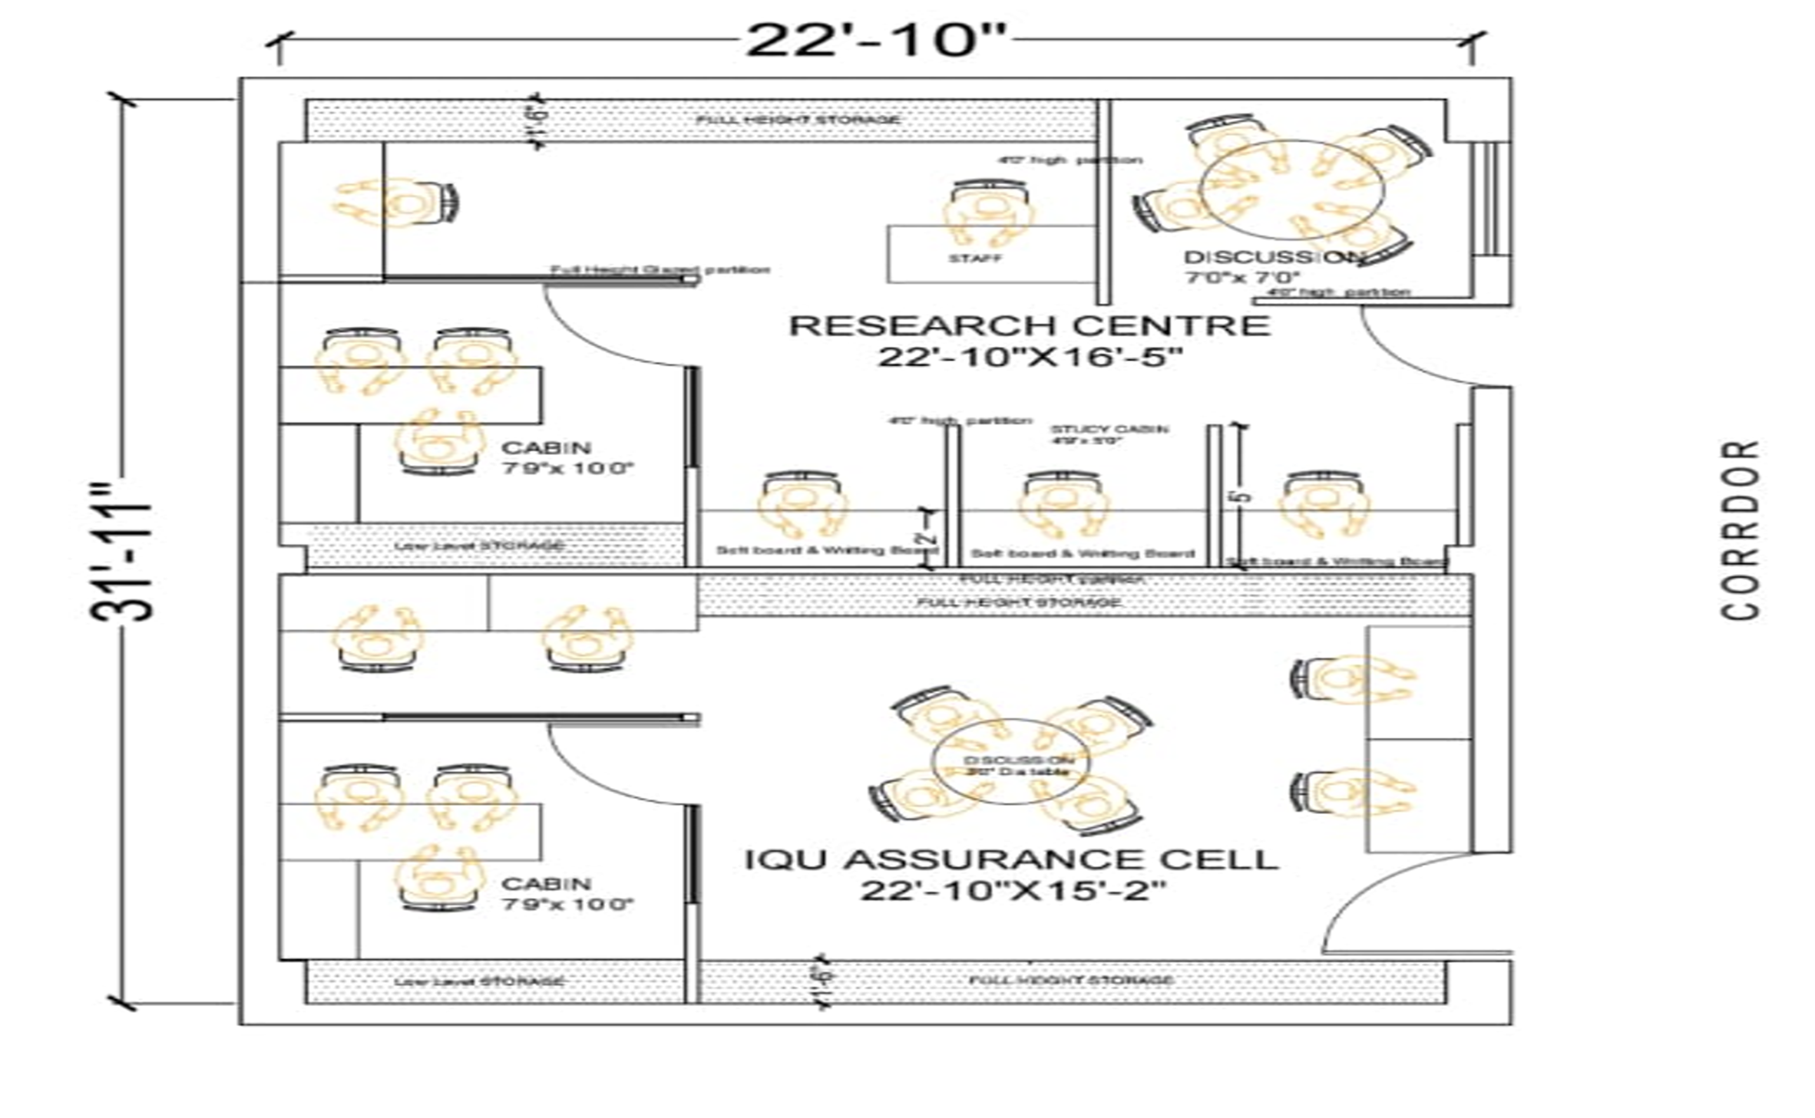
Go, change the world
RV Institute of
Management
Agenda Point : 6
To discuss about the Infrastructure enhancement in the Institution
IQAC and Research Centre Renovation - in progress

Slide 12
Go, change the world
RV Institute of
Management
Agenda Point : 7
To discuss about the new quality initiatives adopted by the institute:
Strengthening the BIP – Faculty mentors visiting the organisations where their mentees are carrying out internship
Formation of the RAC
Participation in the National Management Week organized by AIMS
Successful submission of data for the Subject Rating by QS I Gauge
Approval of Research Promotion policy & Ph.D Guidelines

Slide 13
RV Institute of
Management
Go, change the world
Strengthening the BIP – Faculty mentors visiting the organisations where their mentees are carrying out internship
The programme is designed to gain a preliminary understanding of an organization, its functions, process and policies. The purpose of Business Immersion Programme is to develop required skills and competencies to emerge as a good business leader and thinker.
The Faculty at RVIM visited their Mentees' organizations where the mentees were undergoing their Business immersion experience( Internship).
The visit also enabled an Industry- Academia collaboration and exploration of several collaboration scope for the future in the form of Placement drives, Internships, Guest lectures, Consultancy, Industry Interaction in any other way possible. Additionally it led the way to the mentees' performance evaluation.

Slide 14
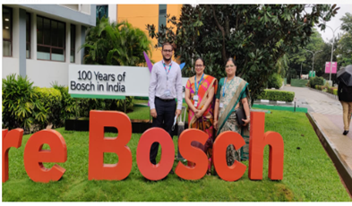
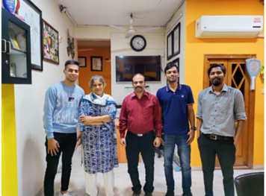
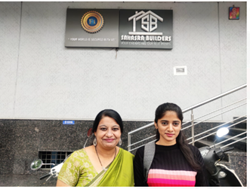
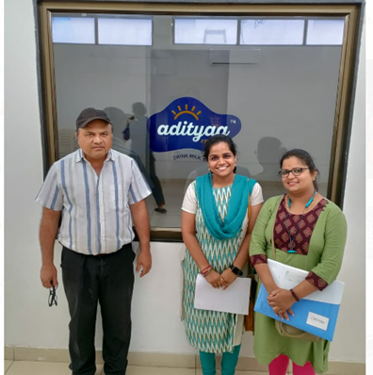

Slide 15
RV Institute of
Management
Go, change the world
Participation in the National Management Week organized by AIMS
The college is participating in AIMS National Management Week 2022. As part of the program, week-long programs are organized from 1st August to 7th August'22. All the events provide a platform for students to involve themselves and render services through activities that contribute to societal change. Several events was organized through the week.
The summary of events conducted during the National Management Week held from 1st August to 7th August 2022. Director, Staff Members, Students, Helping Staff and all had participated and supported the activities.

Slide 16
Date | Event | Public/ Beneficiaries | Students Volunteers | Teaching Staff | Non-Teaching Staff | Total
Aug 1 | Awareness on Traffic Rules | 60 | 25 | 4 | 5 | 94
Aug 2 | Public Awareness on advantages of Rainwater Harvesting | 46 | 15 | 7 | 4 | 72
Aug 2 | Visit to Rainwater Harvesting Information Centre | - | 16 | 4 | 1 | 21
Aug 3 | Poster Making on the theme “Awareness of Sustainable Development Goals” | - | 45 | 20 | 7 | 72
Aug 3 | Animal Welfare Event - Sharing Food to Stray Dogs | - | 14 | 6 | 7 | 27
Aug 4 | Visit to Differently Abled Children - Samarthanam Trust | 464 | 6 | 2 | - | 502
Aug 4 | Visit to NGO - Rainbow | 16 | 5 | 3 | 2 | 26
Aug 4 | Yoga & Meditation for Senior Citizens | 35 | 1 | 3 | 3 | 42
Aug 5 | Public Awareness Program on continuing to follow COVID guidelines | 150 | 165 | 18 | - | 333
Aug 6 | Free Health Checkup | 87 | 64 | 18 | 16 | 185
Aug 6 | Visit to Mentally Challenged Children School | 30 | 10 | 3 | - | 43
Aug 7 | Public Awareness Program on 75th year India’s Independence ‘Azadi Ka Amruth Mahotsav’ | 300 | 7 | 2 | 2 | 311
 | TOTAL | 1,188 | 359 | 84 | 40 | 1,698

Slide 17
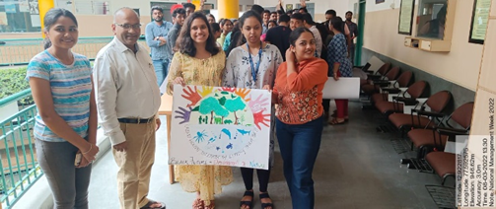
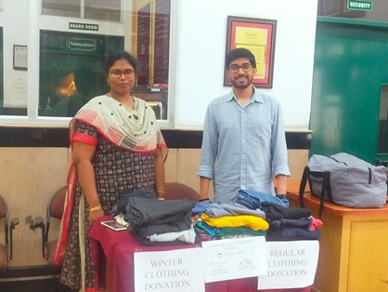
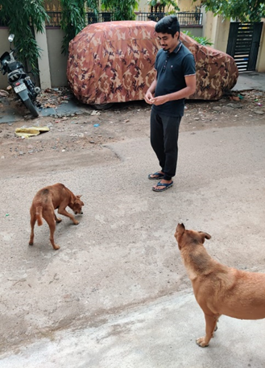
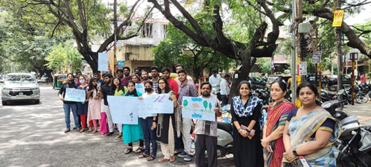
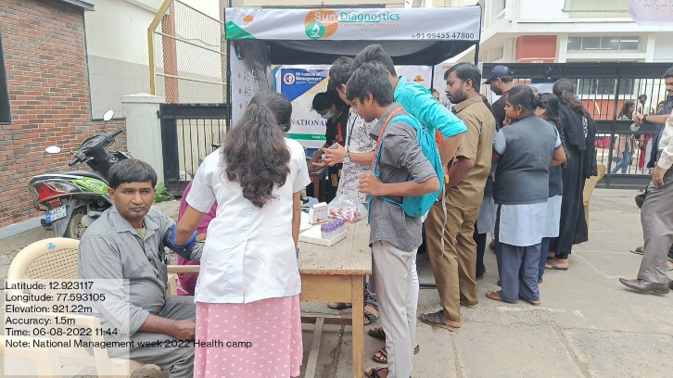

Slide 18
Go, change the world
RV Institute of
Management
We propose to start our own Ph.D Programme
Ph D Guidelines - 2022.pdf
PHD REGULATIONS Final.ppt

Slide 19
Go, change the world
RV Institute of
Management
Agenda Point : 8
To present the details regarding programmes organized in the Institute during the previous quarter and the way forward.

Slide 20
Go, change the world
Programmes (FDP/MDP/Symposium/Workshops/CEP/Certificate courses) organized
RV Institute of
Management
SI.No | Date | Events/Activity Organized | Resource Person/Designation
1 | 04-05-2022 to 06-05-2022 | Workshop on Social Media Tools | Ms. Mitcch Duddani, Manager, Wildcraft
2 | 09-05-2022 | Workshop On Economics – Pricing Strategies | Dr. Pushkarni Panchamukhi, Assistant Dean, RV University
3 | 11-05-2022 | Workshop On Values | Mr. Shrihari Udupa, Director, Agora Analytics, Bangalore
4 | 14-05-2022 | Blood Donation Camp In Association with Rotary Club, Jayanagar (3190) | Rtn. Fazal Mahmood, District Governor Rtn. Keshav S, District Secretary Rtn. P V Rai, Zonal Governor Rtn. Dr. James Thomas, Asst. Governor Rtn. Shobha Murali, Zonal Secretary
6 | 14-05-2022 | Digital Skill for Future an Evolving Learning Culture In Association with NHRD | Mr. Amit Sharma, CHRO, Volvo Group India Mr. Manas Das Gupta, Head, Wealth Technology India, ANZ Capt. Harikrishna, Head, Learning and Leadership Development, Allstate Dr. Nadeesh Hiremath, EC member, NHRD, Bangalore Chapter
7 | 04-04-2022 to 01-05-2022 | Students Visit to Villages as a part of UBA on E Sanjeevani OPD Awareness
8 | 01-06-2022 | Cyber Jagrukta Diwas
9 | 05-06-2022 | World Environment Day

Slide 21
Go, change the world
Programmes (FDP/MDP/Symposium/Workshops/CEP/Certificate courses) organized
RV Institute of
Management
SI.No | Date | Events/Activity Organized | Resource Person/Designation
10 | 4-06-2022 | Awareness Program on Insolvency Profession In Association with IBBI ( Insolvency and Bankruptcy Board of India) as part of AKAM | Mr.Ritesh Kavadia, Executive Director, IBBI Ms.Karishma Rastogi, Monitoring and inspection officer, IPAICAI Ms.CMA Manjula, Insolvency Professonal.
11 | 09-06-2022 | Workshop on Crafting a Manuscript for Quality Publication | Dr. Amitabh Anand from France
12 | 09-06-2022 | MDP ON Real Wold Analytics Challenge In Association with SetConnect, USA | Mr.Ramesh Rajagopalan,CEO, Set Connect, USA.
13 | 11-06-2022 | Panel Discussion On Demystifying Investment for Startups | Mr. Sheshadri Iyer, CEO & Managing Partner, Sandesha Global Ventures Mr. Anuj Sharma, Founder & CEO, ALSiSAR Impact Mr. Sujay Dixit, Vice President, Innovation & Excellence
14 | 21-06-2022 to 27-06-2022 | International Yoga Day | Dr. Purushottam Bung, Director, RVIM
15 | 18-06-2022 | FDP on Design Thinking | Dr. Jayan Sen, Associate VP, Head of L & D, Infosys Ltd. Mr. Dinesh Rao, Infosys

Slide 22
Go, change the world
Programmes (FDP/MDP/Symposium/Workshops/CEP/Certificate courses) organized
RV Institute of
Management
SI.NoL | Date | Events/Activity Organized | Resource Person/Designation
16 | 29-06-2022 | Investor Awareness Programme – Financial Literacy | Mr.Vishal, Director, BFCI, Bangalore.
17 | 07-07-2022 | Global Business Risk Management, FEMA & Trade Tariff | Mr. David Rasquinha, Former Managing Director & Chief Executive Office, Export Import Bank of India
18 | 11-07-2022 | Industrial Visit to the Labour Department, Government of Karnataka | Dr. G Manjunath, Additional Labour Commissioner, Bangalore
19 | 13-07-2022 | Role of Depository System and Its Importance | Mr. Harisha, Regional Head, CDSL, Bangalore
20 | 15-07-2022 | Industrial Visit to MARG-Business Transformation Consulting Firm | Ms. Sudheshna Roy, Founder & CEO, MARG
21 | 22-07-2022 | Certificate Programme On Universal Human Values | Prof. Vidyadhara Hegde, RVIM
22 | 23-07-2022 | National Seminar on Indian Philosophers Day In Association with ICPR | Dr. S Ranganath, Revered Sanskrit Scholar Dr. M K Shridahr, Registrar S Vyasa University Dr. Arathi V B, Chairperson, Vibhu Academy Dr. A H Chachadi, Fr. DeanKousali Institute of Management

Slide 23
Go, change the world
Programmes (FDP/MDP/Symposium/Workshops/CEP/Certificate courses) organized
RV Institute of
Management
SI.No | Date | Events/Activity Organized | Resource Person/Designation
23 | 01-08-2022 to 06-08-2022 | FDP on Advanced Machine Learning Algorithms For Real Time Applications Using R & Python | Mr. Shreedhar Deshmukh Dr. Dhaval Maheta
24 | 06-08-2022 | How Did I Get Investment? –Startups | Mr. Sheikh Samiullah, Fast Beetle Ms. Shirok Lily Shazia, NagaEd Mr. Vikrant Pandey, Fight Back Mr. Anuj Sharma, ALSiSAR Impact
25 | 19-08-2022 to 20-08-2022 | HR Conclave – Rethink, Redesign, Restructure and Reinforce | UPCOMING EVENT

Slide 24
RV Institute of
Management
Go, change the world
Update on Placements
Particulars | 2019-21 | 2020-22 (Ongoing)
Total no. of companies (on/off campus) | 65 | 52
Total no. of students | 176 | 177
No. of students not opted for placements | 16 | 5
Total no. of students opted for placements | 160 | 172
No. of students placed | 141 | 144
Effective % of placements | 89% | 83.72%
Maximum CTC offered | 12 L/A | 12.56 L/A
Median Package | 5.5 L/A | 5.75 L/A

Slide 25
Go, change the world
Institutional Achievements: B School Ranking
RV Institute of
Management
SL | NAME OF THE MAGAZINE/PORTAL | DATE OF ISSUE/ WEBSITE | CATEGORY | Ranking 2020 | RANKING 2021
01 | BUSINESS TODAY in association with MDRA 2021 | November 14,2021 Special Issue | All India level Ranking for best Return on Investment (ROI) | 22nd | 25th
 |  |  | All India level Ranking (Private colleges) | 75th | 64th
 |  |  | All India level Ranking for Future Orientation | NA | 100th
 |  |  | OVERALL RANKING (All India Level - Pvt & Govt) | 133th | 129th
02 | THE WEEK2021 in association with HANSA Research | November 14,2021 Special Issue | TOP B-SCHOOL - ALL INDIA LEVEL | 100th | 86th
 |  |  | SOUTH ZONE - ALL INDIA LEVEL | 32nd | 25th
 |  |  | B-SCHOOLS BENGALURU METRO | 10th | 09th
03 | OUTLOOK – ICARE 2022 | November 22 ,2021 | ALL INDIA LEVEL | 68th | 63rd
 |  |  | TOP PRIVATE B-SCHOOLS South Zone | NA | 20th
 |  |  | PRIVATE AFFILIATED COLLEGES – ALL INDIA LEVEL | 5th | 05th
04 | NATIONAL EDUCATIONAL EXCELLENCE AWARDS & CONFERENCE 2021 | September 23,2021 | Awarded “Outstanding Performance in Virtual Knowledge Delivery during Pandemic”

Slide 26
Go, change the world
RV Institute of
Management
Agenda Point : 9
To seek suggestions from the members regarding continuous quality improvement

Slide 27
Go, change the world
RV Institute of
Management
Agenda Point : 10
Any other issues with the permission of the chair

Slide 28
Go, change the world
RV Institute of
Management
Discussions.....

