Slide 1
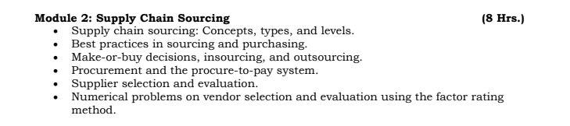
MODULE 2- SUPPLY CHAIN SOURCING

Slide 2
Supply Chain Sourcing: Concept
Sourcing refers to the process of identifying, evaluating, selecting, and managing suppliers to procure goods, services, or capabilities required for business operations.
Sourcing is a strategic supply chain function, not just purchasing.
Focuses on cost, quality, reliability, risk, and sustainability.
Impacts overall supply chain performance and competitiveness.
Example:
A smartphone manufacturer sourcing processors, screens, batteries, and logistics services from different suppliers worldwide

Slide 3
Importance of Sourcing in Supply Chain
Sourcing plays a critical role in:
Cost reduction and margin improvement
Ensuring uninterrupted supply
Quality assurance of inputs
Risk mitigation (supply disruptions, geopolitical risk)
Innovation through supplier collaboration
Example:
During COVID-19, firms with diversified sourcing networks faced fewer disruptions than firms dependent on single suppliers

Slide 4
Sourcing vs Purchasing
Sourcing and purchasing are related but not the same.
Sourcing:
Strategic and long-term
Supplier selection and relationship management
Focus on total cost of ownership
Purchasing:
Operational and transactional
Order placement and payment
Focus on price and delivery
Example:
Sourcing decides which steel supplier to partner with.
Purchasing places monthly orders with the selected supplier.

Slide 5
Types of Sourcing – Overview
Sourcing strategies can be classified based on:
Number of suppliers
Geographic location
Ownership and control
Risk appetite
Major types:
Single sourcing
Multiple sourcing
Global sourcing
Local sourcing
Outsourcing
Insourcing

Slide 6
Single Sourcing
Single sourcing means procuring a particular input from one supplier only.
Characteristics:
Long-term supplier relationship
High dependency on supplier
Potential for cost efficiencies and quality consistency

Slide 7
SINGLE SOURCING
Advantages:
Better coordination and trust
Volume discounts
Easier quality control
Disadvantages:
High risk of supply disruption
Supplier power increases
Example:
An automobile firm sourcing engines from one approved manufacturer

Slide 8
Multiple Sourcing
Multiple sourcing involves procuring the same input from two or more suppliers.
Characteristics:
Reduced dependency on one supplier
Competitive pricing among suppliers
Improved supply reliability
Advantages:
Risk diversification
Flexibility in supply
Better negotiation power
Disadvantages:
Higher coordination cost
Less volume discount per supplier
Example:
FMCG companies sourcing packaging materials from multiple vendors

Slide 9
Global Sourcing
Global sourcing refers to procuring goods or services from international suppliers.
Reasons for global sourcing:
Lower production cost
Access to specialized skills or technology
Availability of raw materials
Challenges:
Longer lead times
Currency risk
Trade barriers and tariffs
Example:
Apparel brands sourcing garments from Bangladesh and Vietnam

Slide 10
Five Heads of Income
Income from Salary
Income from House Property
Profits and Gains from Business or Profession
Capital Gains
Income from Other Sources
Every income must fall under one head only.

Slide 11
Local / Domestic Sourcing
Local sourcing involves procuring from suppliers within the same country or region.
Advantages:
Shorter lead times
Lower transportation cost
Better communication and control
Supports local economy
Limitations:
Higher cost compared to global suppliers
Limited supplier base
Example:
Food delivery platforms sourcing vegetables from local farmers

Slide 12
Outsourcing
Outsourcing is the practice of contracting external firms to perform activities previously done in-house.
Commonly outsourced functions:
Manufacturing
Logistics
IT services
Customer support
Benefits:
Focus on core competencies
Cost savings
Access to expertise
Risks:
Loss of control
Quality issues
Dependency on vendors
Example:
A company outsourcing logistics operations to a 3PL provider

Slide 13
Insourcing
Insourcing involves performing activities internally within the organization.
Reasons for insourcing:
Protect critical knowledge
Improve quality control
Strategic importance of activity
Advantages:
Greater control
Better confidentiality
Faster decision-making
Disadvantages:
Higher fixed costs
Need for internal expertise
Example:
A technology firm developing software in-house instead of outsourcing

Slide 14

Apple Inc. – Strategic Global Sourcing for Competitive Advantage
Industry Context:
Apple Inc. operates in the consumer electronics industry, characterized by:
Rapid technological innovation
Short product life cycles
High demand volatility
Strong cost and quality pressures
To maintain premium positioning while controlling costs, Apple relies heavily on strategic global sourcing.

Slide 15
Apple Inc. – Strategic Global Sourcing for Competitive Advantage
2. Sourcing Challenge Faced by Apple
Apple faced multiple sourcing-related challenges:
High cost of manufacturing in the US.
Need for advanced component technology.
Requirement for large-scale, fast production ramp-ups
Managing supply chain risks across countries

Slide 16
Apple Inc. – Strategic Global Sourcing for Competitive Advantage
3. Apple’s Sourcing Strategy
Apple follows a multi-layered sourcing model:
a) Global Sourcing
Components sourced globally from specialized suppliers:
  Semiconductors from Taiwan.
  Displays from South Korea.
  Sensors from Europe.
Assembly outsourced to large contract manufacturers in China and India.
b) Multiple Sourcing
Critical components sourced from more than one supplier to reduce risk
This prevents dependency on a single supplier.
Example:
iPhone display panels sourced from multiple manufacturers.

Slide 17
Apple Inc. – Strategic Global Sourcing for Competitive Advantage
c) Outsourcing:
Manufacturing and assembly
Logistics operations
d) Insourcing:
Product design
Chip architecture
Software development
This allows Apple to:
Protect intellectual property
Focus on core competencies
Achieve cost efficiency

Slide 18
Apple Inc. – Strategic Global Sourcing for Competitive Advantage
CONCLUSION:
Strategic sourcing goes beyond cost minimization.
Multiple and global sourcing reduce supply risk.
Outsourcing must be balanced with insourcing.
Supplier partnerships create long-term value.

Slide 19
Apple Inc. – Strategic Global Sourcing for Competitive Advantage
CONCLUSION:
Strategic sourcing goes beyond cost minimization.
Multiple and global sourcing reduce supply risk.
Outsourcing must be balanced with insourcing.
Supplier partnerships create long-term value.

Slide 20

Mahakumbh as a Benchmark Case for Best Practices in Sourcing & Purchasing

Slide 21
Mahakumbh as a Benchmark Case for Best Practices in Sourcing & Purchasing
The Mahakumbh Mela is one of the strongest real-life examples of large-scale, time-bound, public-sector sourcing and procurement excellence.
Managing supplies for millions of pilgrims over a short duration requires precision, transparency, and resilience, making it ideal for discussing best practices in sourcing and purchasing.

Slide 22
Why Mahakumbh is a Sourcing Masterclass
Scale: Procurement for food, water, tents, sanitation, healthcare, transport, power
Time constraint: Everything must be ready before the event begins
Public accountability: Government-funded, audited, and transparent
Uncertain demand: Footfall varies daily, weather-dependent
https://youtu.be/r4HvQK0WoD8?si=65eLmAS9cxA1EaDj

Slide 23
Best Practices in Sourcing & Purchasing Illustrated through Mahakumbh
1. Advance Demand Forecasting & Planning
Use of historical data from previous Kumbh events
Buffer sourcing for essentials (water, medical supplies, sanitation)
Phased procurement schedules aligned with event timelines
Best Practice: Forecast-based sourcing with contingency buffers

Slide 24
Best Practices in Sourcing & Purchasing Illustrated through Mahakumbh
2. Multi-Supplier Sourcing Strategy
Avoids dependency on a single vendor
Separate suppliers for:
  Temporary shelters
  Food grains
  Sanitation equipment
  Medical supplies
Best Practice: Risk mitigation through supplier diversification

Slide 25
Best Practices in Sourcing & Purchasing Illustrated through Mahakumbh
3. Local Vendor Development
Preference to local MSMEs and regional suppliers
Reduced transportation cost and lead time
Faster replenishment and better responsiveness.
Best Practice: Local sourcing for agility and cost efficiency

Slide 26
Best Practices in Sourcing & Purchasing Illustrated through Mahakumbh
4. Transparent & Standardized Procurement
Government e-tendering platforms
Clear specifications, price caps, and service-level agreements (SLAs)
Competitive bidding ensures fair pricing
Best Practice: Ethical, transparent purchasing processes

Slide 27
Best Practices in Sourcing & Purchasing Illustrated through Mahakumbh
5. Centralized Procurement with Decentralized Distribution
Central contracts for bulk items (tents, toilets, power equipment)
Decentralized issue points across sectors of the mela area
Best Practice: Central cost control + decentralized operational flexibility

Slide 28
Best Practices in Sourcing & Purchasing Illustrated through Mahakumbh
6. Quality & Compliance Management
Pre-event vendor inspections
Quality checks for:
  Food safety
  Medical supplies
  Structural safety of temporary installations.
Best Practice: Quality assurance embedded in sourcing decisions

Slide 29
Best Practices in Sourcing & Purchasing Illustrated through Mahakumbh
7. Emergency & Spot Purchasing Protocols
Fast-track approvals for unforeseen requirements
Pre-approved vendor lists for emergency procurement
Best Practice: Flexible purchasing systems for uncertainty management

Slide 30
Best Practices in Sourcing & Purchasing Illustrated through Mahakumbh
8. Sustainability-Oriented Sourcing
Biodegradable materials (plates, cups)
Eco-friendly toilets and waste management systems
Controlled single-use plastic procurement
Best Practice: Green sourcing in large-scale events

Slide 31


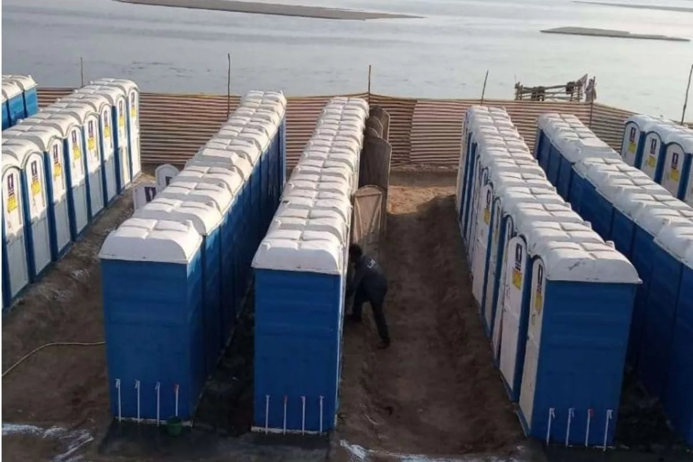

Tata Group (Tata Trusts) – Sanitation & Hygiene Sourcing at Mahakumbh

Slide 32
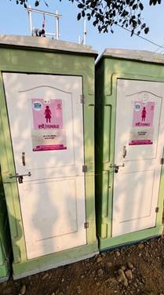
Tata Group (Tata Trusts) – Sanitation & Hygiene Sourcing at Mahakumbh
A widely cited and academically accepted brand example from Mahakumbh is the Tata Group (through Tata Trusts), which played a significant role in sanitation infrastructure and hygiene solutions, aligning perfectly with best practices in sourcing and purchasing.

Slide 33
How Tata Group Demonstrated Best Practices in Sourcing & Purchasing
1. Strategic Supplier Selection
Partnered with multiple sanitation solution providers
Selected vendors with proven large-scale public sanitation expertise
Sourcing Best Practice: Capability-based supplier evaluation
2. Localized Procurement & Vendor Development
Materials and services sourced from regional manufacturers and contractors
Local labor trained for installation and maintenance
Sourcing Best Practice: Local sourcing to reduce lead time and enhance responsiveness

Slide 34
How Tata Group Demonstrated Best Practices in Sourcing & Purchasing
3. Standardization of Specifications
Uniform design specifications for:
  Toilets
  Waste disposal units
  Cleaning equipment
Sourcing Best Practice: Standard specs enable bulk purchasing and cost control
4. Bulk & Centralized Purchasing
Large-volume procurement lowered per-unit costs
Central contracting with decentralized deployment across mela zones
Sourcing Best Practice: Economies of scale with operational flexibility

Slide 35
How Tata Group Demonstrated Best Practices in Sourcing & Purchasing
5. Quality, Health & Safety Compliance
Focus on:
  Hygiene standards
  Ease of maintenance
  Environmental safety
Sourcing Best Practice: Quality and compliance-driven purchasing

Slide 36
How Tata Group Demonstrated Best Practices in Sourcing & Purchasing
6. Sustainable Sourcing
Use of eco-friendly materials
Emphasis on waste segregation and safe disposal
Sourcing Best Practice: Sustainability integrated into sourcing decisions

Slide 37
Levels of Sourcing
In supply chain management, sourcing decisions are made at different levels, based on time horizon, decision authority, and impact on organizational performance.
These are commonly classified into three levels: Strategic, Tactical, and Operational sourcing.

Slide 38
Levels of Sourcing
1. Strategic Sourcing (Long-Term Level):
Time horizon: Long term (3–5 years)
Decision makers: Top management / Supply chain heads
Key Focus
Make-or-buy decisions
Supplier selection & partnership formation
Global vs local sourcing
Sustainability & risk management
Decisions
Single vs multiple sourcing
Outsourcing vs in-house production
Long-term contracts & alliances
Ex: Industry: Automobile (Maruti Suzuki)
Decision: Long-term partnership with Tier-1 suppliers (e.g., engine parts, electronics)

Slide 39
Levels of Sourcing
2. Tactical Sourcing (Medium-Term Level)
Time horizon: Medium term (6 months – 2 years)
Decision makers: Procurement managers
Key Focus
Cost optimization
Contract negotiation
Supplier performance evaluation
Demand planning & volume allocation
Typical Decisions
Annual rate contracts
Order quantities & delivery schedules
Vendor rating systems.
Ex: Industry: FMCG (HUL – Hindustan Unilever)
Decision: Annual contracts for packaging materials (bottles, cartons, labels)

Slide 40
Levels of Sourcing
3. Operational Sourcing (Short-Term Level):
Time horizon: Short term
Decision makers: Supervisors, Operational level employees
Key Focus
Purchase order execution
Expedite orders
Emergency procurement
Invoice processing & compliance
Typical Decisions
Spot purchases
Handling shortages & delays
Vendor coordination at site.
Ex: Industry: Retail (Reliance Retail)
Decision: Daily purchase orders

Slide 41
Make-or-Buy Decision
Brand: boAt (Imagine Marketing Ltd.):
boAt became one of India’s fastest-growing audio and wearable brands by appealing directly to Gen-Z and young millennials. Instead of following a traditional manufacturing-heavy model, boAt faced a crucial make-or-buy decision early in its growth phase.
The Make-or-Buy Decision
Should boAt:
Make products in-house by setting up manufacturing units, or
Buy (outsource) manufacturing while focusing on design, branding, and distribution?

Slide 42
Make-or-Buy Decision
Decision Taken: Asset-Light Hybrid Model
MAKE (In-House Capabilities)
1. Product Design & R&D
Industrial design
Sound tuning and user experience
Product roadmaps aligned with Gen-Z trends.
Why MAKE?
Design differentiation
Faster response to fashion & tech trends
Control over customer experience

Slide 43
Make-or-Buy Decision
Decision Taken: Asset-Light Hybrid Model
MAKE (In-House Capabilities)
2. Branding & Marketing
Influencer marketing
Youth-centric campaigns
Community building

Slide 44
Make-or-Buy Decision
Decision Taken: Asset-Light Hybrid Model
BUY (Outsourced Activities)
1. Manufacturing
Contract manufacturing partners (China & India)
No heavy capital investment in plants
Why BUY?
Lower fixed costs
Scalability
Faster product launches.
2. Component Sourcing
Chips, batteries, drivers sourced from global suppliers

Slide 45
Make-or-Buy Decision
Decision Taken: Asset-Light Hybrid Model
Outcomes
Rapid market penetration in audio & wearables
High brand recall among Gen-Z
Competitive pricing
Ability to launch multiple SKUs quickly

Slide 46
Procurement
Procurement is the process of acquiring goods and services required by an organization from external suppliers.
It focuses on obtaining the right quality, quantity, price, time, and supplier.
Procurement includes planning, supplier selection, negotiation, and purchasing.
Effective procurement helps in cost control, quality improvement, and value creation for the organization.

Slide 47
Procure-to-Pay (P2P) System
Procure-to-Pay (P2P) is an end-to-end process that integrates procurement and accounts payable activities.
It starts with purchase requisition and supplier selection and ends with supplier payment.
The system ensures process control, transparency, and compliance through approvals and documentation.
An effective P2P system reduces costs, errors, and cycle time while improving supplier relationships.

Slide 48
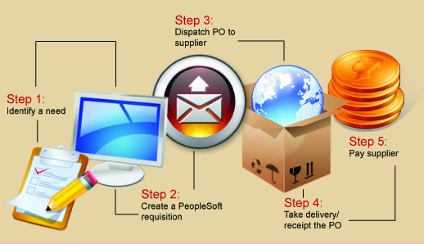
Procure-to-Pay (P2P) System
PURCHASE ORDER
ESTABLISH NEED
SUPPLIER PAYMENT
RECEIPTS & INSPECTION
PURCHASE REQUISITION

Slide 49
Procure-to-Pay (P2P) process
Step 1: Identify a Need:
The process begins when a department or employee identifies a requirement for goods or services.
This could be office equipment, raw materials, software, or services.
The requirement is checked against budget availability and business necessity.
This step ensures that purchases are need-based and planned, not impulsive.
Example:
The IT department realizes it needs new desktop computers for new employees.

Slide 50
Procure-to-Pay (P2P) process
Step 2: Create a Requisition
A Purchase Requisition (PR) is created. The PR includes:
  Item description
  Quantity
  Estimated cost
  Delivery location
  Budget code
The requisition goes through an approval workflow (manager → finance → procurement).
Control purpose:
Prevents unauthorized and off-budget purchases.
Example:
IT raises a requisition for 20 desktops and gets approval from the IT head and finance.

Slide 51
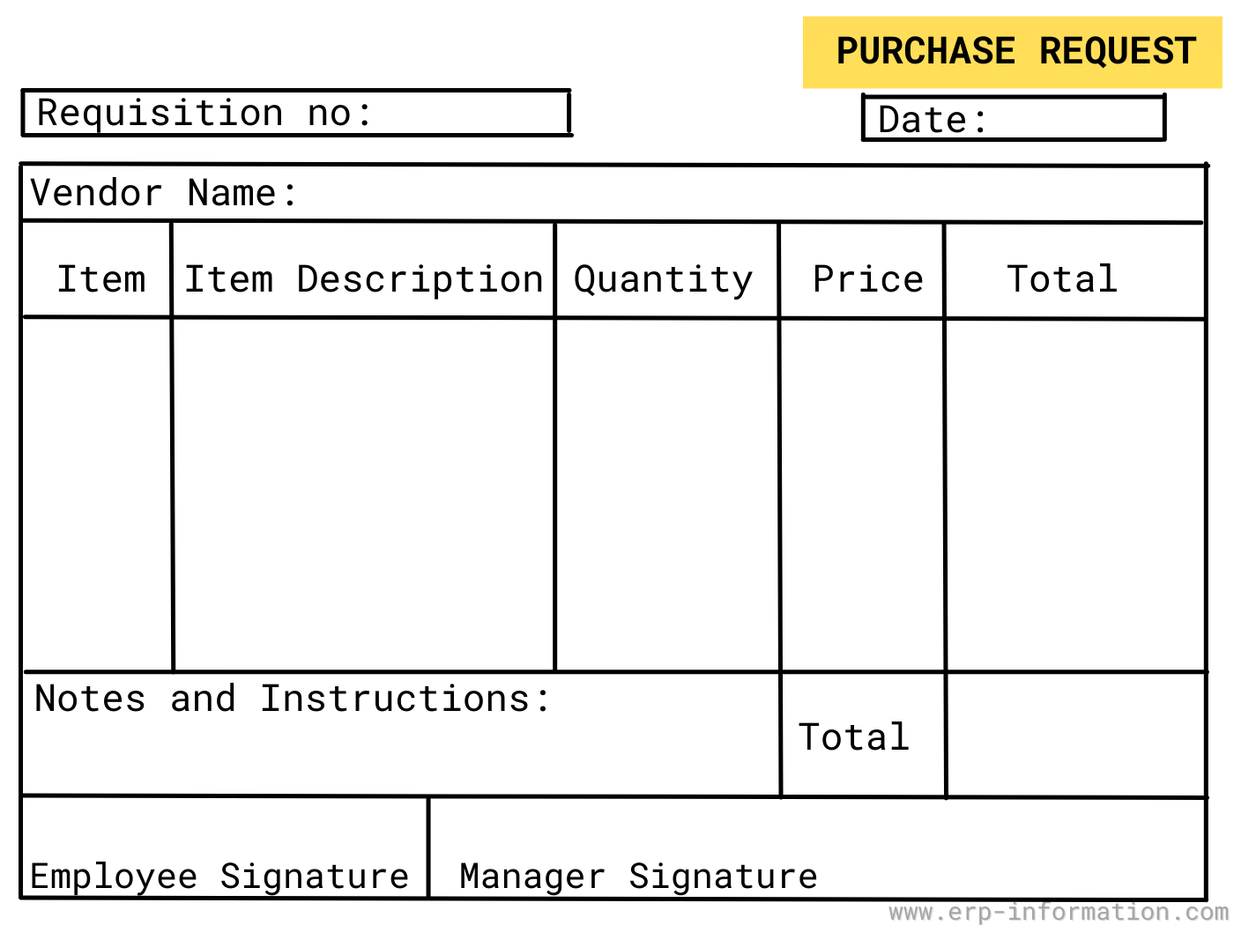

Slide 52
Procure-to-Pay (P2P) process
Step 3: Dispatch Purchase Order (PO) to Supplier
Once the requisition is approved, the procurement team converts the PR into a Purchase Order (PO).
The PO is a legal document sent to the supplier.
It clearly specifies:
  Quantity
  Price
  Delivery date
  Payment terms
The PO is dispatched electronically (email / ERP portal).
Example:
Procurement issues a PO to an approved computer vendor with agreed prices and 30-day credit terms.

Slide 53
Procure-to-Pay (P2P) process
Step 4: Take Delivery / Receipt of the PO
The supplier delivers the goods as per the PO.
The receiving department:
  Checks quantity and quality
  Confirms delivery
A Goods Receipt Note (GRN) is created in the system.
This confirms that goods/services have been actually received.
Control purpose:
Ensures payment is made only for what is received.
Example:
The warehouse receives 20 desktops, inspects them, and records the GRN

Slide 54
Procure-to-Pay (P2P) process
Step 5: Pay Supplier
The supplier submits an invoice.
Accounts Payable performs three-way matching:
  Purchase Order (PO)
  Goods Receipt Note (GRN)
  Supplier Invoice
If all details match, payment is approved and released.
Payment is made as per agreed terms (NEFT / RTGS / cheque).
Control purpose:
Prevents overpayment, duplicate payment, and fraud.
Example:
After successful matching, finance pays the vendor within 30 days.

Slide 55
Procure-to-Pay (P2P) process
Process Summary :
Need → Requisition → Purchase Order → Receipt → Payment

Slide 56
Supplier Selection & Evaluation
Supplier selection and evaluation is a systematic process of identifying, assessing, and monitoring suppliers
Ensures procurement of right quality, cost, delivery, and reliability
Plays a key role in cost control, risk management, and long-term competitiveness

Slide 57
Supplier Selection & Evaluation
Supplier Selection Criteria:
Quality performance (defects, rejections)
Delivery performance (on-time delivery)
Cost performance (price stability, cost reduction)
Service level (responsiveness, communication)
Compliance (contract, ethical, legal)

Slide 58
Supplier Selection & Evaluation
Objectives of Supplier Evaluation
Measure supplier performance objectively
Improve supplier quality and delivery
Identify gaps and improvement areas
Reduce procurement risks
Strengthen buyer–supplier relationship

Slide 59
Supplier Selection & Evaluation
Vendor Rating Methods:
Categorical Method – qualitative judgment (Good/Average/Poor).
Weighted Point Method – numerical scores with weights.
Cost Ratio Method – cost of poor performance added to price.

Slide 60
Supplier Selection & Evaluation
Frequency of Supplier Evaluation
Monthly – for critical suppliers: Suppliers of Key raw materials, High-value components, Items affecting production continuity.
Quarterly – for regular suppliers: Suppliers of Packaging materials, Maintenance supplies, Standard services.
Annually – for strategic suppliers (Long-term partners, Suppliers involved in: Product development, Innovation, Technology sharing).
Continuous monitoring through ERP systems

Slide 61
Supplier Selection & Evaluation
Conclusion
Supplier selection is a strategic decision, not a one-time activity
Supplier evaluation ensures continuous improvement
Together, they form the backbone of effective procurement and supply chain management.

Slide 62

Supplier Selection & Evaluation
Fabindia — Ethical Sourcing and Supplier Evaluation
Company Overview:
Fabindia Overseas Pvt. Ltd. is a leading Indian retail brand that sources and sells handcrafted products made by rural artisans across India, including apparel, home furnishings, organic foods, personal care and more. It has a vast retail network with hundreds of outlets across India and several international stores.

Slide 63
Supplier Selection & Evaluation
Fabindia — Ethical Sourcing and Supplier Evaluation
Leading Indian lifestyle retail brand
Focus on handcrafted apparel, home & organic products
Strong presence across India and select international markets
Supply base: rural artisans and craft clusters

Slide 64
Supplier Selection & Evaluation
Fabindia — Ethical Sourcing and Supplier Evaluation
Decentralized and artisan-based supply chain
Suppliers are individual artisans or artisan groups
Emphasis on sustainability, heritage, and quality
Long-term supplier relationships over short-term cost focus

Slide 65
Supplier Selection & Evaluation
Fabindia — Ethical Sourcing and Supplier Evaluation
Supplier Identification:
Artisans identified through regional craft clusters
Evaluation of traditional skills and craftsmanship
Alignment with Fabindia’s ethical and sustainability values
Willingness to scale production with quality consistency

Slide 66
Supplier Selection & Evaluation
Fabindia — Ethical Sourcing and Supplier Evaluation
Supplier Selection Criteria
Product quality and craftsmanship
Ability to meet design specifications
Consistency in output
Delivery reliability
Responsiveness to feedback
Commitment to ethical practices

Slide 67
Supplier Selection & Evaluation
Fabindia — Ethical Sourcing and Supplier Evaluation
Supplier Evaluation Process
Initial trial orders issued
Quality and design checks by internal teams
Monitoring of delivery timelines
Feedback loop for continuous improvement
Performance review before scaling order volumes

